Slide 1
Lifestyle
By Hui Zhou, Nicole Morris, & Qi Lui

Slide 2
Design Lead
Nicole Morris

Slide 3
Our App
Demo

Slide 4
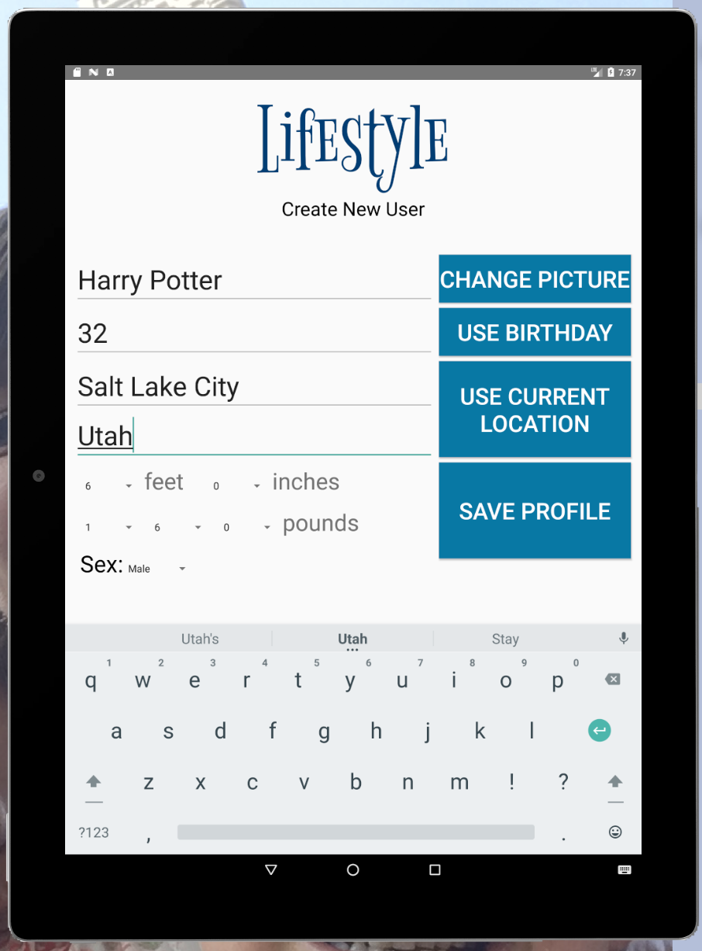
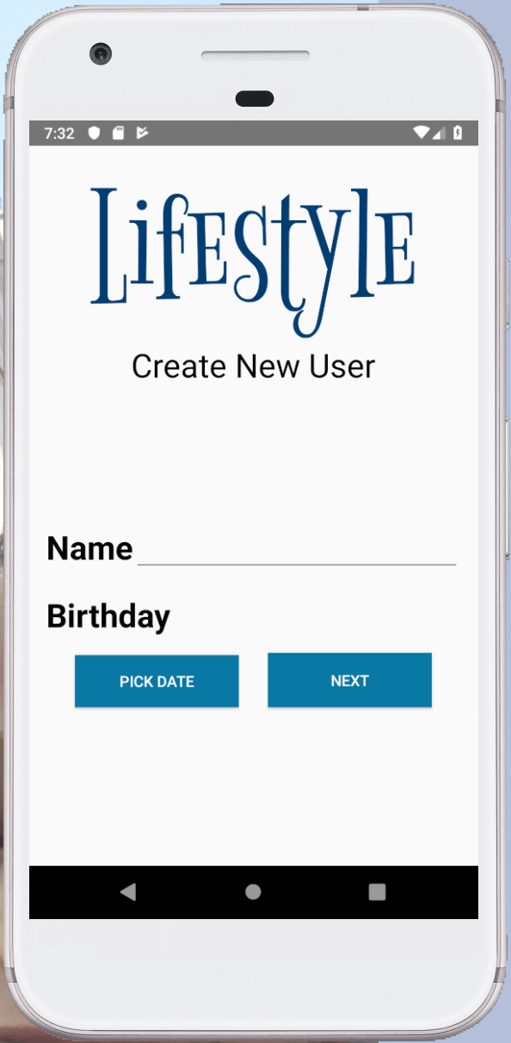
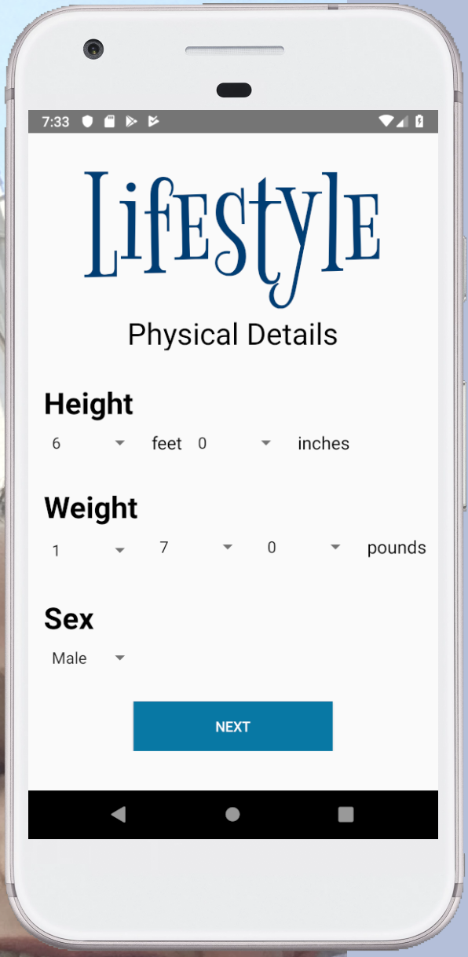
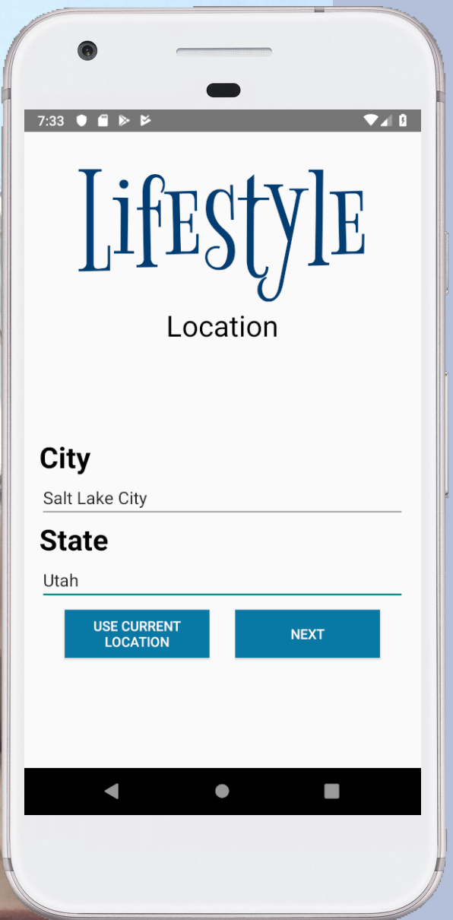
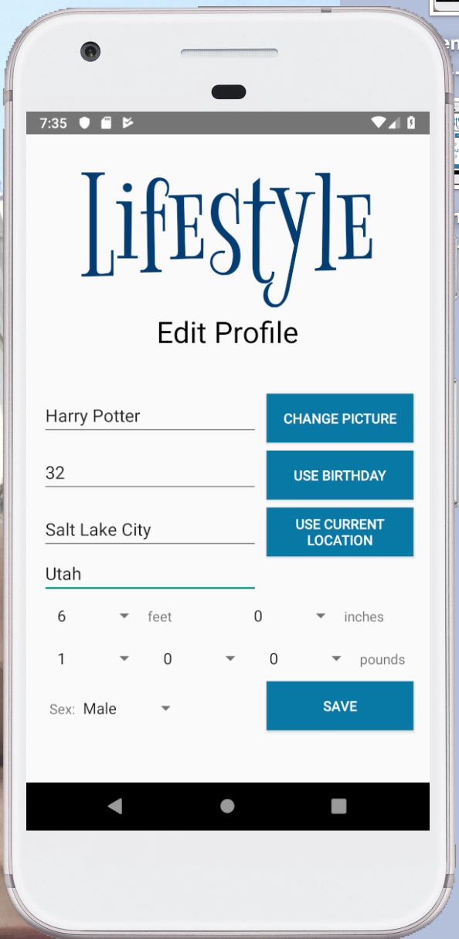
Phone vs Tablet
New User

Slide 5
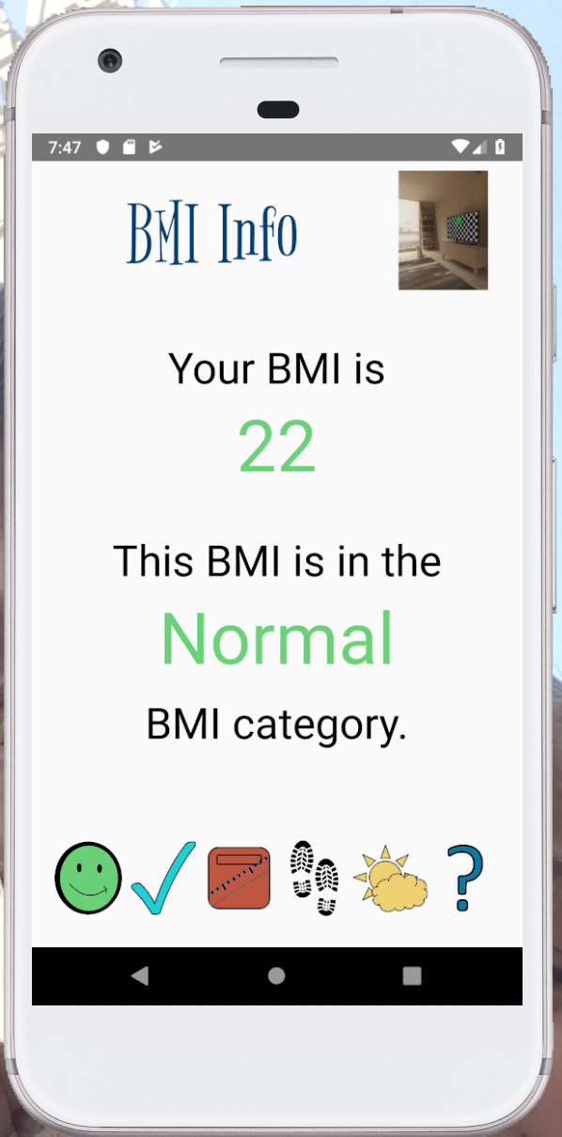
Phone vs Tablet
Menu Bar

Slide 6
Phone vs Tablet
Rotation

Slide 7
Team Lead
Qi Lui

Slide 8
Test Lead
Hui Zhou

